Slide 1
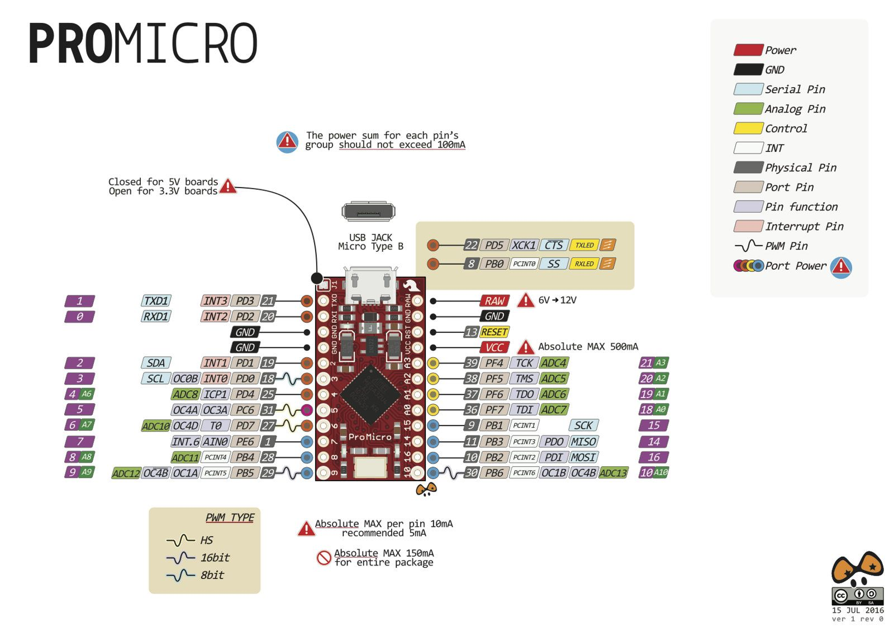
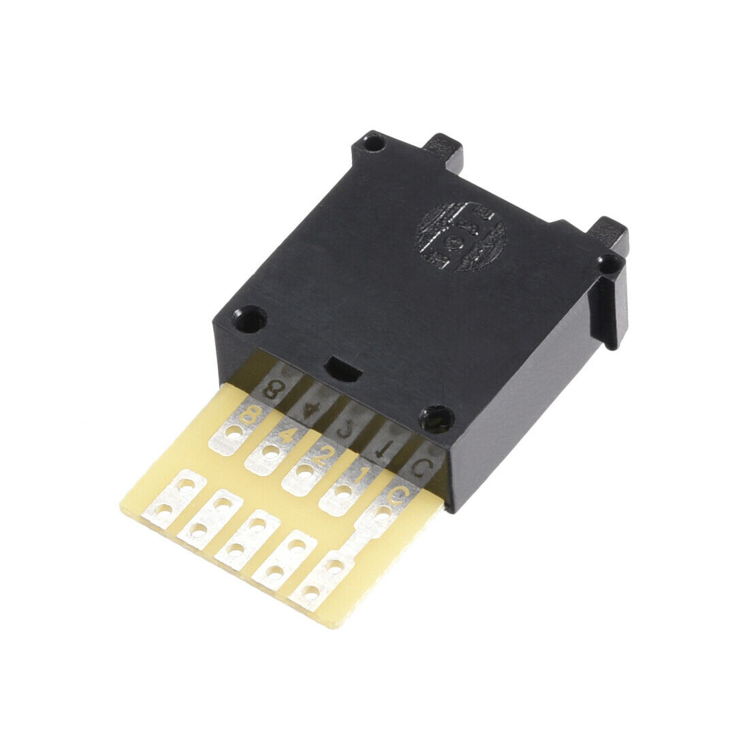
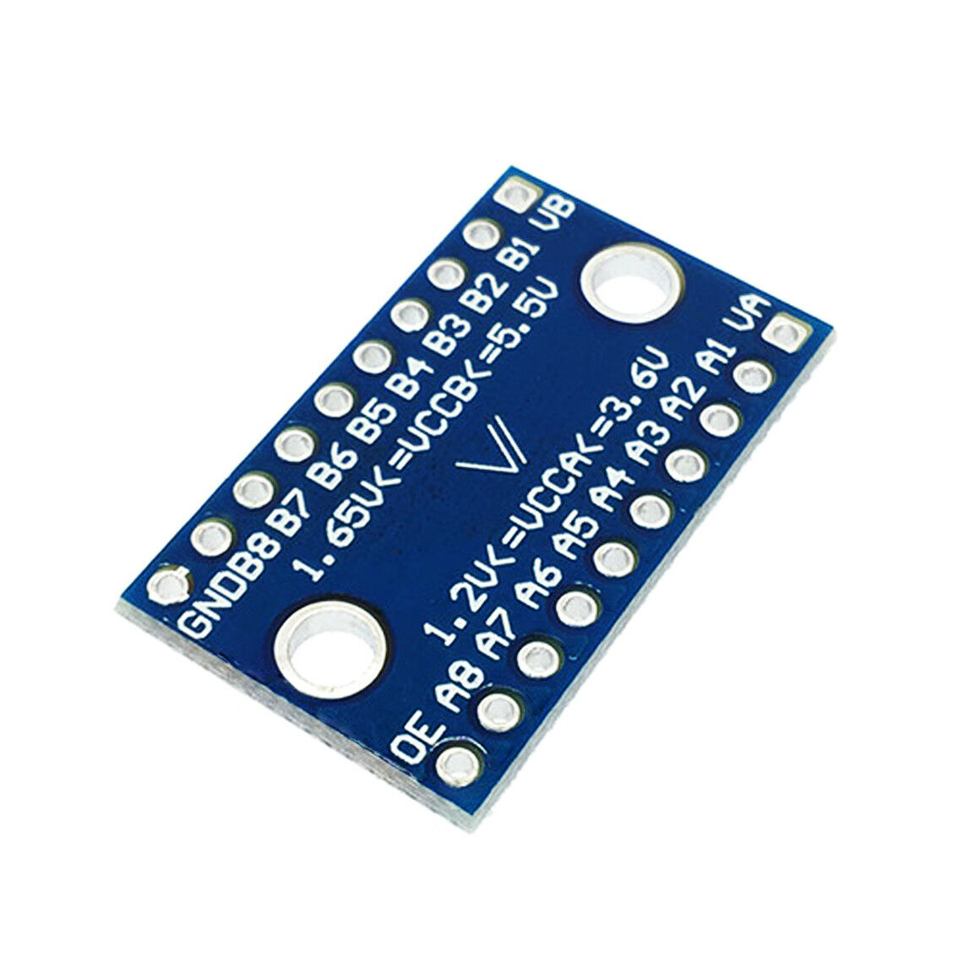
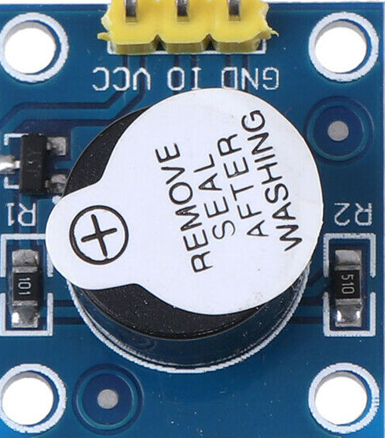
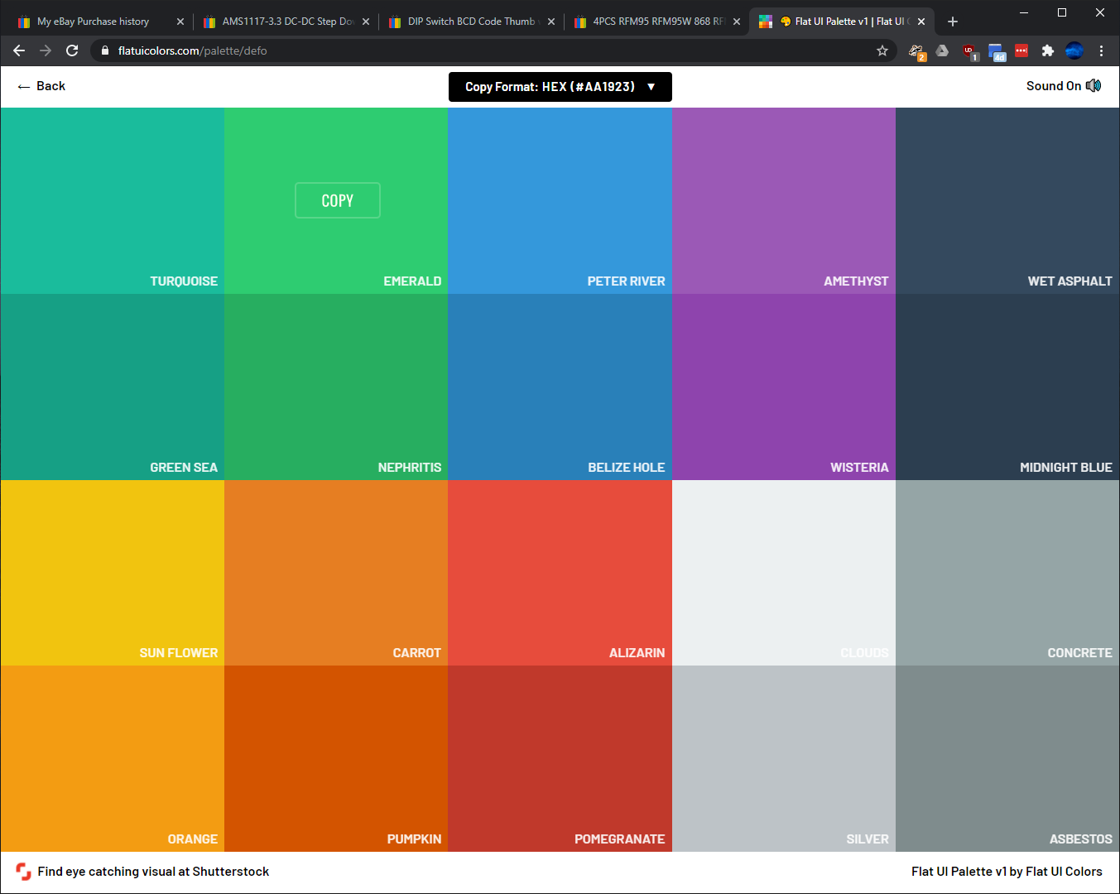
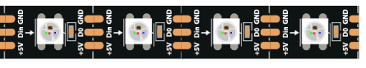
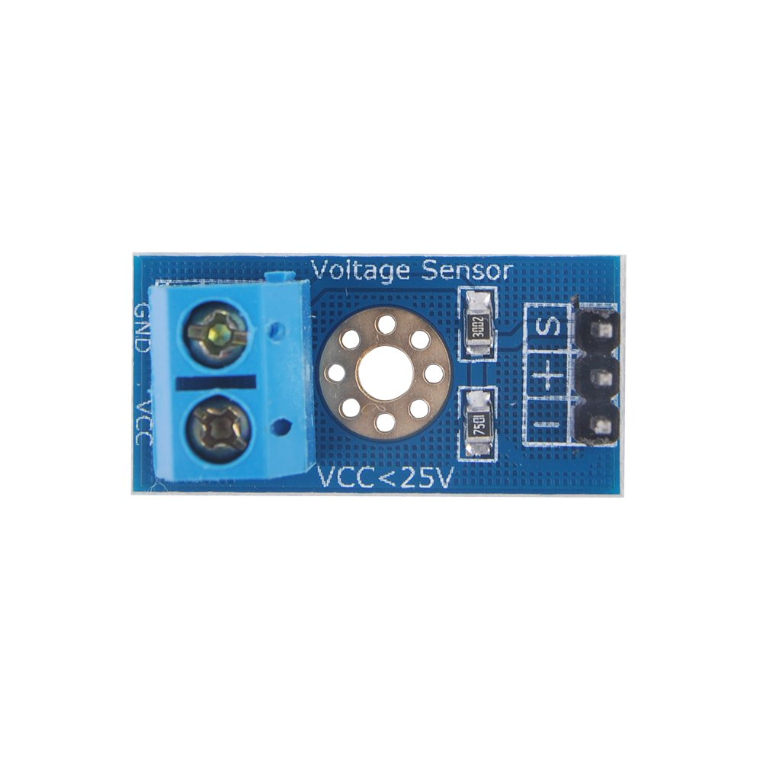
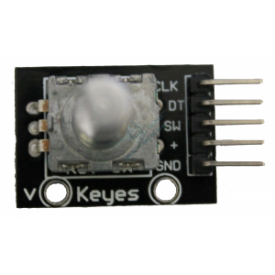
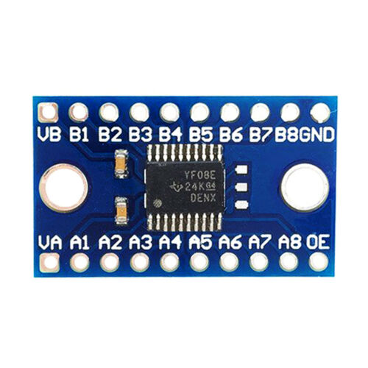
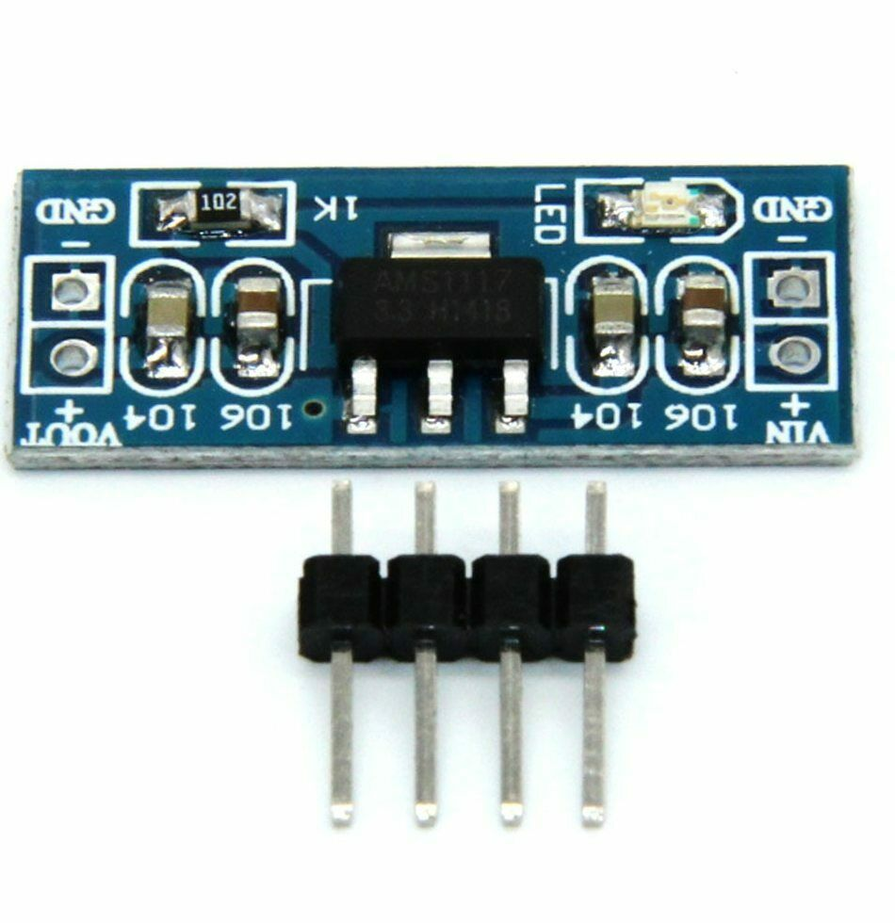
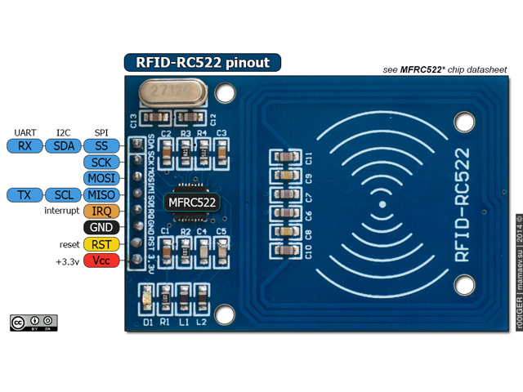
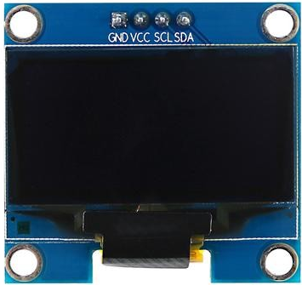
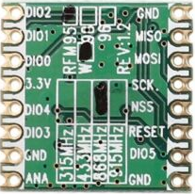
LORA
GND | Black | GND
MISO | White | PA6
MOSI | Grey | PA7
SCK | Purp | PA5
CS | Blue | PB0 / PA4
DI 0 | Grn | PA15 / PA1
3V3 | Yell | 3V3
LIPO V | 1C | 3C
Min | 3.0 | 9.0
Nominal | 3.7 | 11.1
Full | 4.2 | 12.6
RST NFC
CS ‘SDA’ NFC
CS ‘NSS’ LoRa
SCK
MISO
MOSI
RST LoRa
NFC
SDA | Purp | PA1
SCK | Blu | PA5
MOSI | Grn | PA7
MISO | Yell | PA6
GND | Or | GND
RST | Red | PA4
3V3 | Brown | 3V3
5V
Note: Arduino Leonardo interrupt pins are 0, 1, 2 & 3 only
IR Receiver needs to be on interrupt
LoRa DIO0 needs to be on interrupt
NFC
SDA | Black | PB0
SCK | White | PB3
MOSI | Grey | PB5
MISO | Purp | PB4
GND | Blue | GND
RST | Grn | PB1
3V3 | Yell | 3V3
3V3

Slide 2
LORA
GND | Black | GND
MISO | White | PA6
MOSI | Grey | PA7
SCK | Purp | PA5
CS | Blue | PB0 / PA4
DI 0 | Grn | PA15 / PA1
3V3 | Yell | 3V3
LIPO V | 1C | 3C
Min | 3.0 | 9.0
Nominal | 3.7 | 11.1
Full | 4.2 | 12.6
RST NFC
CS ‘SDA’ NFC
-
SCK
MISO
MOSI
-
NFC
SDA | Purp | PA1
SCK | Blu | PA5
MOSI | Grn | PA7
MISO | Yell | PA6
GND | Or | GND
RST | Red | PA4
3V3 | Brown | 3V3
5V
Note: Arduino Leonardo interrupt pins are 0, 1, 2 & 3 only
NFC
SDA | Black | PB0
SCK | White | PB3
MOSI | Grey | PB5
MISO | Purp | PB4
GND | Blue | GND
RST | Grn | PB1
3V3 | Yell | 3V3
3V3

Slide 3
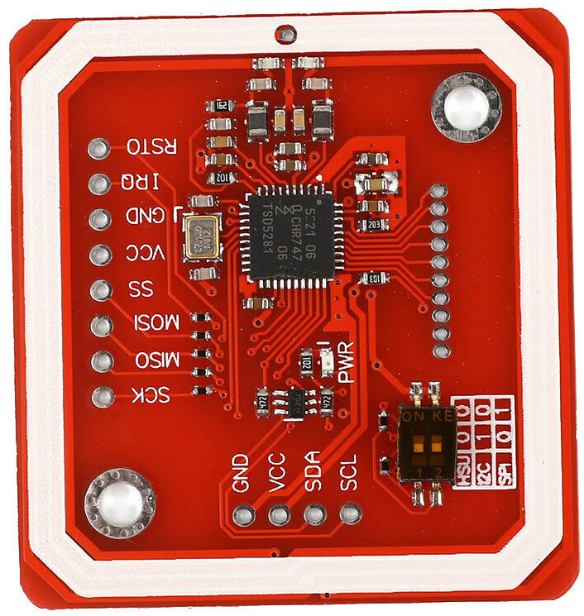
LORA
GND | Black | GND
MISO | White | PA6
MOSI | Grey | PA7
SCK | Purp | PA5
CS | Blue | PB0 / PA4
DI 0 | Grn | PA15 / PA1
3V3 | Yell | 3V3
LIPO V | 1C | 3C
Min | 3.0 | 9.0
Nominal | 3.7 | 11.1
Full | 4.2 | 12.6
NFC
SDA | Purp | PA1
SCK | Blu | PA5
MOSI | Grn | PA7
MISO | Yell | PA6
GND | Or | GND
RST | Red | PA4
3V3 | Brown | 3V3
CS (NSS)
SCK
MISO
MOSI
Reset
Note: Arduino Leonardo interrupt pins are 0, 1, 2 & 3 only
NFC
SDA | Black | PB0
SCK | White | PB3
MOSI | Grey | PB5
MISO | Purp | PB4
GND | Blue | GND
RST | Grn | PB1
3V3 | Yell | 3V3

Slide 4
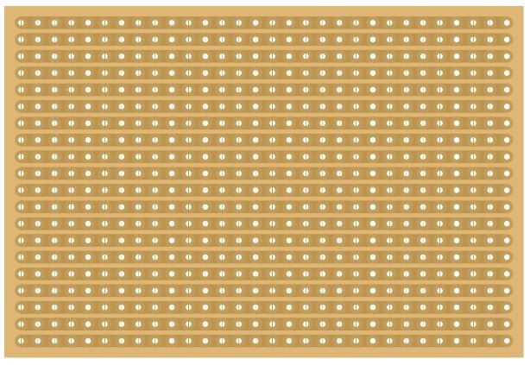
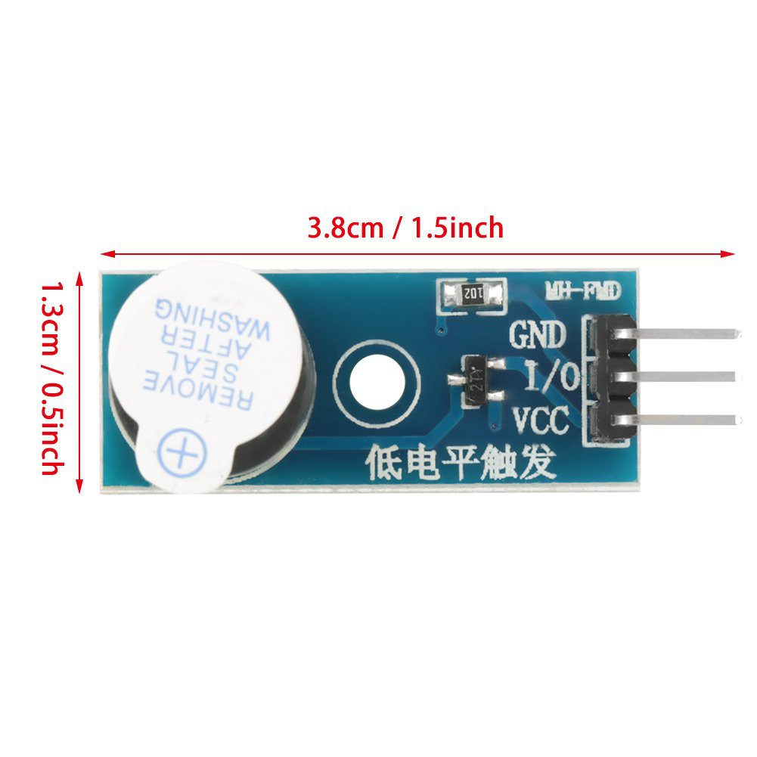
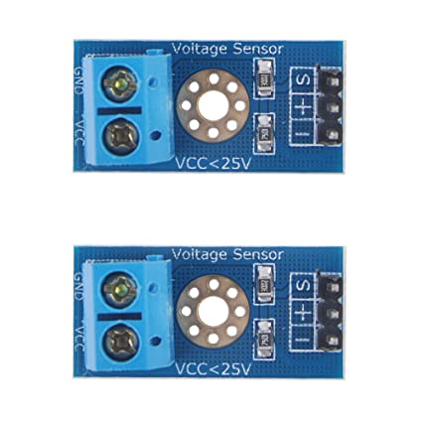
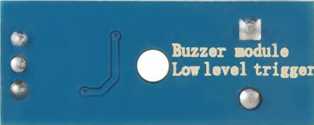
1
2
3
4
5
6
7
8
9
10
11
12
13
14
15
16
17
18
19
20
21
22
23
24
25
26
27
1
2
3
4
5
6
7
8
9
10
11
12
13
14
15
16
17
18
19
20
21
22
23
24
25
26
27
5V IN
GND
+5V
X
X
X
X
X
X
X
X
X
X
X
X
X
X
X
X
X
X
X
X
X
X
X
X
X
X
X
3V3
C-RST
C-SDA
GND
SCK
MISO
MOSI
L-INT
C-RST
C-SDA
L-NSS
SCK
MISO
MOSI
L-RST
X
X
X
X
X
DIO2
DIO1
DIO0 (IRQ)
3V3
DIO4
DIO3
GND
ANT
GND
MISO
MOSI
SCK
(CS) NSS
RST
DIO5
GND
X
X
X
X
X
X
X
X
X
X
X
VCC
I/O
GND

